Slide 1
Facial Emotion Recognition Using Deep Learning

Slide 2
INTRODUCTION
My Name is V. Aniketh. I belong to Hyderabad, Currently I am pursuing my B.E in Computer Science from Nagpur University. I have done my 10th and 12th from Jawahar Navodaya Vidyalaya Rangareddy.
I have Keen Interest in Python, DBMS, Data Analytics.
I also have done certain projects on it as well
My hobbies are Playing Basketball, Gardening etc..

Slide 3
WHAT IS SELF-ANALYSIS
This is my First internship in machine learning.
During this internship ,I got to improve my technical skill as well as soft skills and work on live project in the team.
This Internship is really like eye opening to me that i was able to know so many concepts in machine learning.

Slide 4
SKILLS ACQUIRED IN CDE
Effective communication skills
Website development
Presentation
Self-confidence
Technical knowledge
Learn ML concepts
Real-Time Using ML

Slide 5
INTERNSHIP TASKS
TASK-1: PORTFOLIO
I just have to create our portfolio using any programming language and which mainly includes My Introduction, My Skills, My Projects and My Contact details.
TASK-2: Numpy, Regex, Pandas Exersises
In this task, we have given some questions regarding above topics and we have write the codes of the questions in ide.
TASK-3: Naive Bayes
In this task, we have given questions in naive bayes and to solve the questions.
TASK-4: E- HAC and K-Means
In this task, We have given questions in HAC and K-MEANS to solve

Slide 6
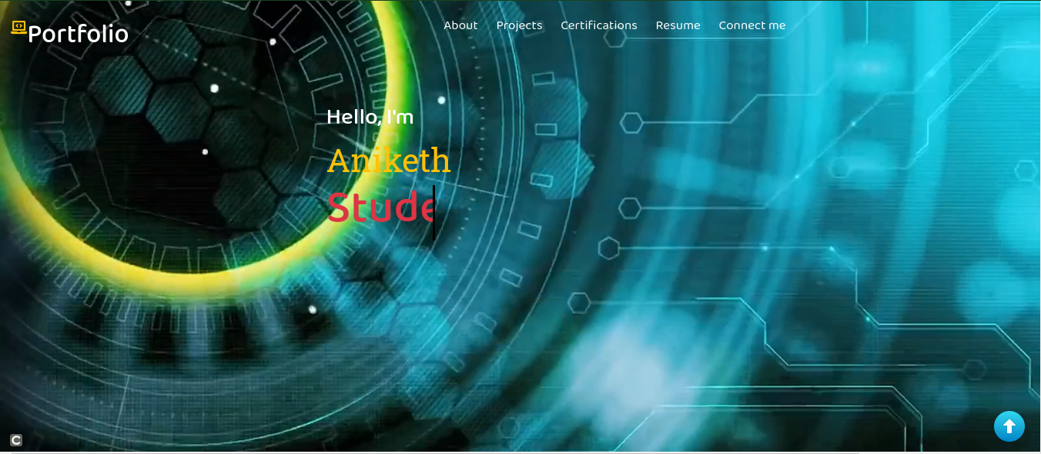
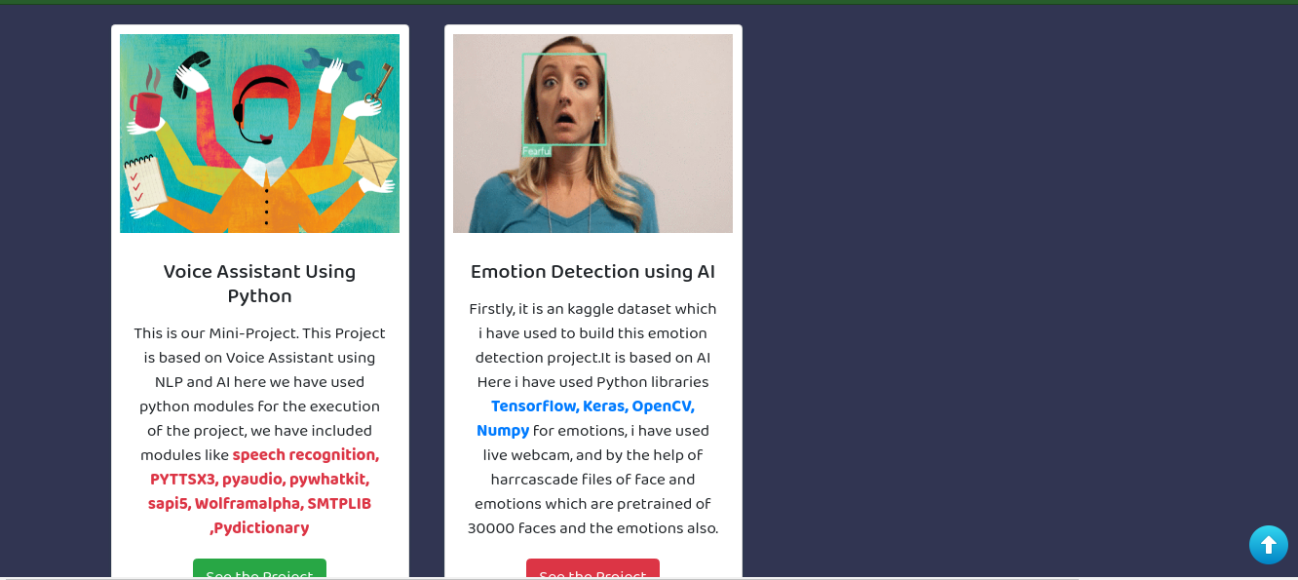
TASKS
1. Creating Portfolio

Slide 7
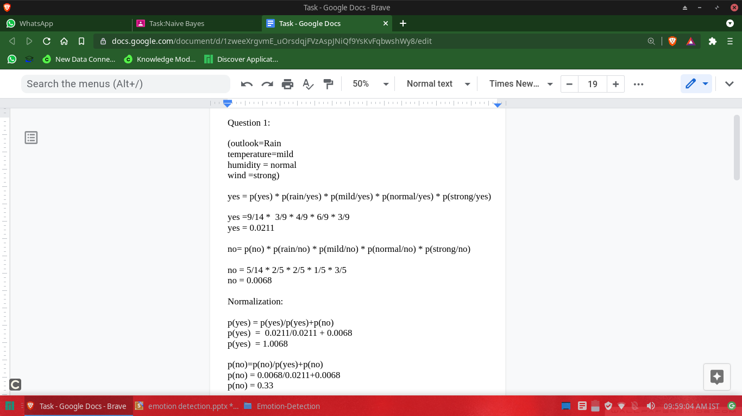
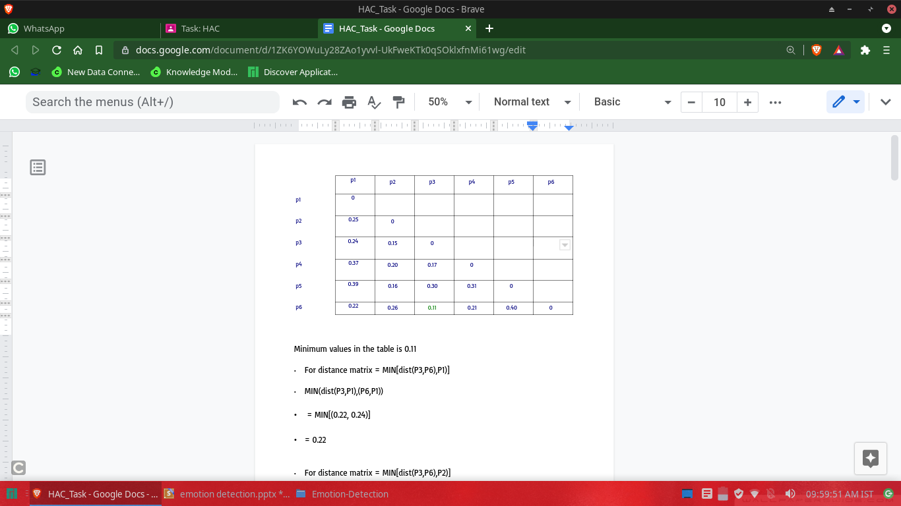
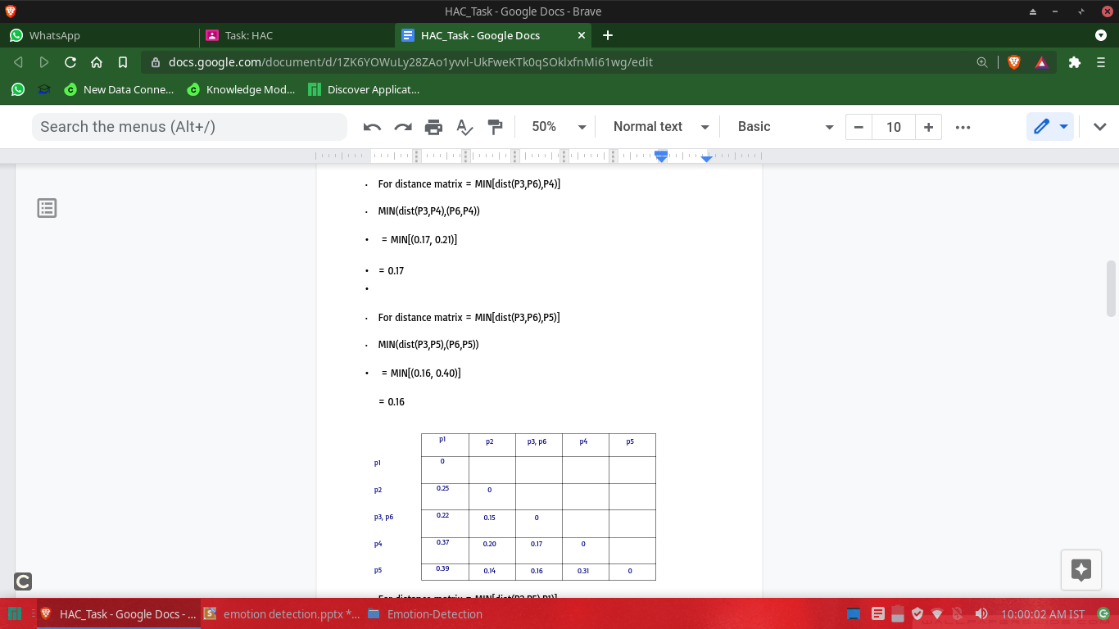
TASKS
2. Manipulaton of string, HAC, PCA, K-Means, Naive Bayes

Slide 8
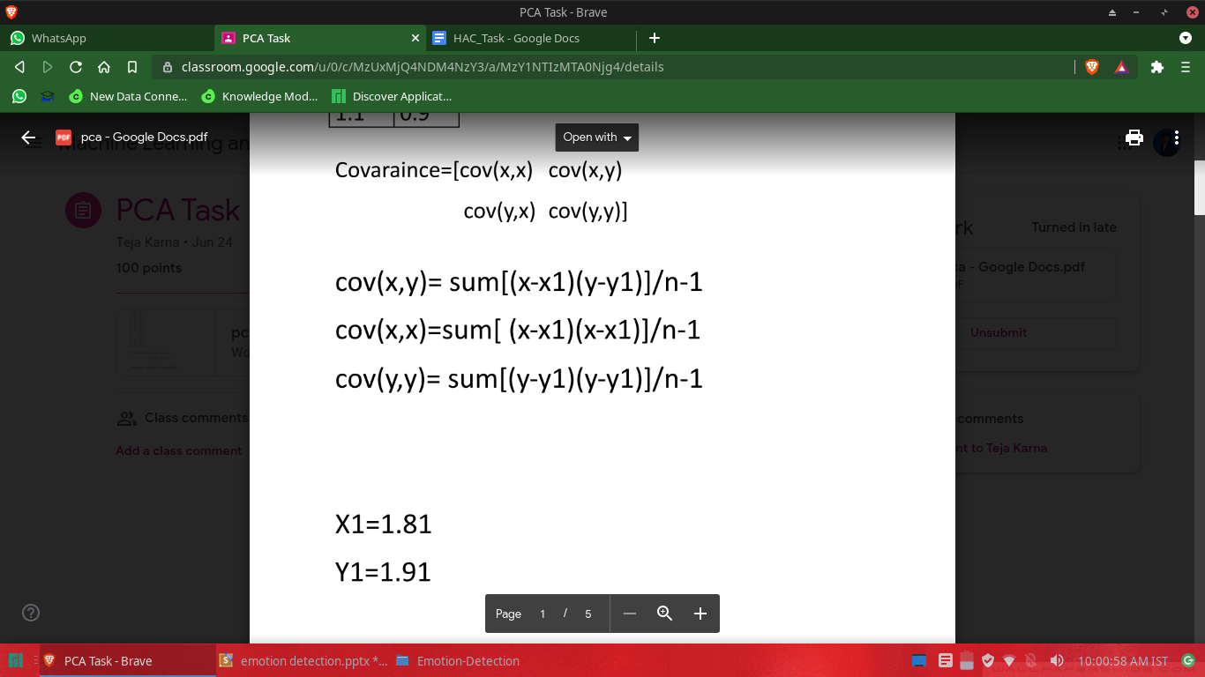
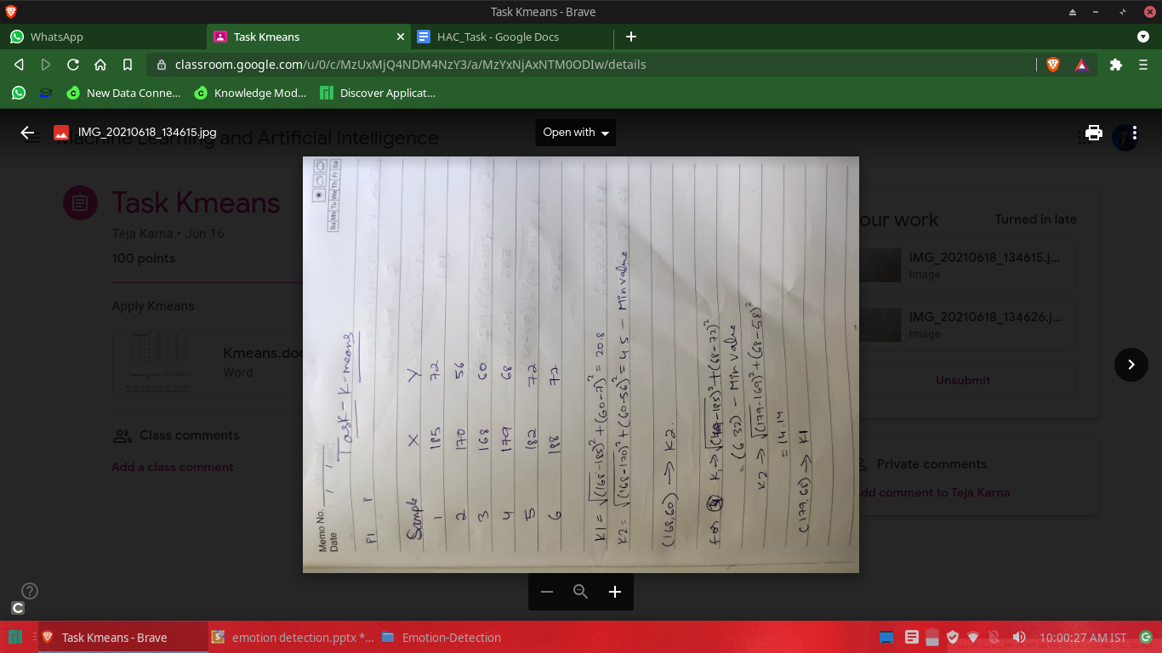
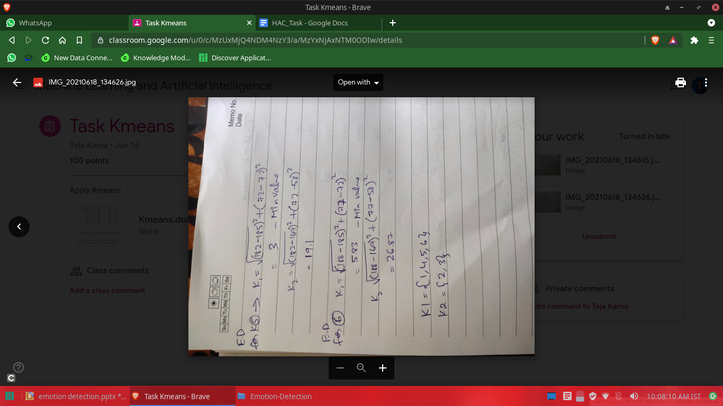
TASKS
2. Manipulaton of string, HAC, PCA, K-Means, Naive Bayes

Slide 9
PROJECT
TOOLS AND LIBRARIES USED
OpenCV
OpenCV is the library we will be using for image transformation functions such as converting the image to grayscale. It is an open source library and can be used for many image functions and has a wide variety of algorithm implementations. C++ and Python are the languages supported by OpenCV. It is a complete package which can be used with other libraries to form a pipeline for any image extraction or detection framework. The range of functions it supports is enormous, and it also includes algorithms to extract feature descriptors.

Slide 10
Python
Python is a powerful scripting language and is very useful for solving statistical problems involving machine learning algorithms. It has various utility functions which help in preprocessing. Processing is fast and it is supported on almost all platforms. Integration with C++ and other image libraries is very easy, and it has in-built functions and libraries to store and manipulate data of all types. It provides the pandas and numpy framework which helps in manipulation of data as per our need. A good feature set can be created using the numpy arrays which can have n-dimensional data

Slide 11
Keras
Keras is an open-source software library that provides a Python interface for artificial neural networks. Keras acts as an interface for the TensorFlow library. Up until version 2.3, Keras supported multiple backends, including TensorFlow, Microsoft Cognitive Toolkit, Theano, and PlaidML.
Keras is:
Simple -- but not simplistic. Keras reduces developer cognitive load to free you to focus on the parts of the problem that really matter.
Flexible -- Keras adopts the principle of progressive disclosure of complexity: simple workflows should be quick and easy, while arbitrarily advanced workflows should be possible via a clear path that builds upon what you've already learned.
Powerful -- Keras provides industry-strength performance and scalability: it is used by organizations and companies including NASA, YouTube, or Waymo.

Slide 12
Visual Studio Code
Visual Studio Code is a source-code editor made by Microsoft for Windows, Linux and macOS. Features include support for debugging, syntax highlighting, intelligent code completion, snippets, code refactoring, and embedded Git. Users can change the theme, keyboard shortcuts, preferences, and install extensions that add additional functionality.
Microsoft has released most of Visual Studio Code's source code on the microsoft/vscode repository of GitHub using the "Code – OSS" name, under the permissive MIT License, while the releases by Microsoft are proprietary freeware.

Slide 13
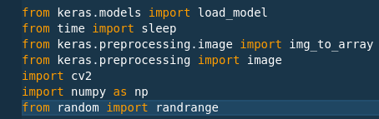
IMPLEMENTED WORK
Stage 1 Implementation
Installation of Python modules and Keras.

Slide 14

IMPLEMENTED WORK
Stage 2 Implementation
Uploading the harcascade files

Slide 15
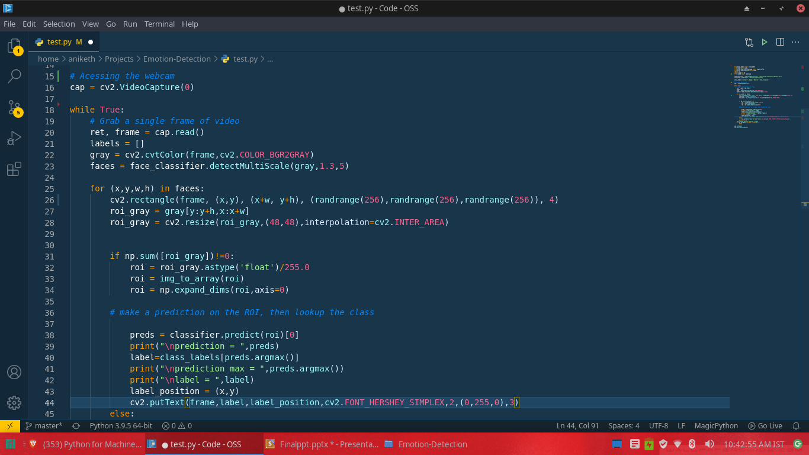
IMPLEMENTED WORK
Stage 3 Implementation
Taking the user imput through Webcam

Slide 16
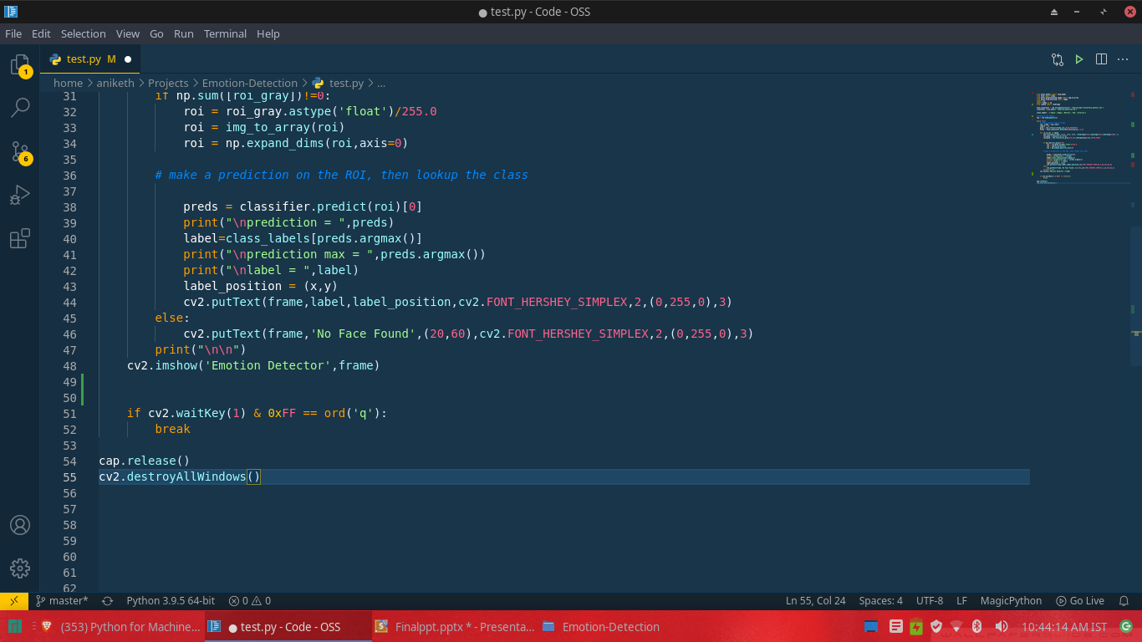
IMPLEMENTED WORK
Stage 4 Implementation
Making prediction of the user

Slide 17
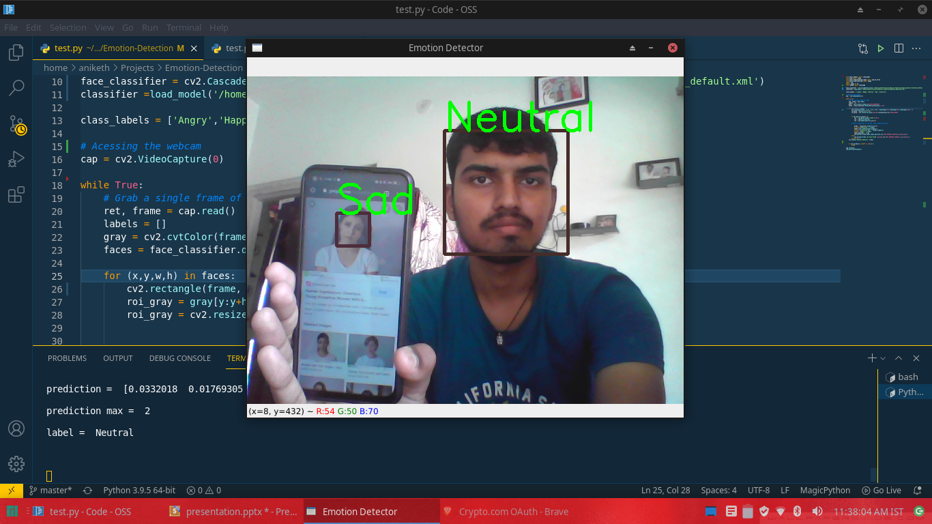
RESULTS AND DISCUSSIONS
Getting Emotional Analysis :

Slide 18
FACTS I LEARNED FROM THIS INTERNSHIP
Firstly, I got a wonderful organization where I fit in beautifully and worked under good mentors.
The work environment was good,friendly,kind and respectful.
I got references ,worked under a beautiful team, met new people, people ahead of me, learned new and improved skills and how to apply them.
I learnt how to test out all the skills that I developed in college and see how they work.

Slide 19
AFTER INTERNSHIP
If I got a chance again to work with CDE i will sure join the CDE because it helped me to gain the confidence in Public Speaking and also in giving presentaion infront of all.
If i got chance in future regarding joining in CDE again i will choose ML domain so because i am well confident in this field.

Slide 20
THANK YOU

